Slide 1
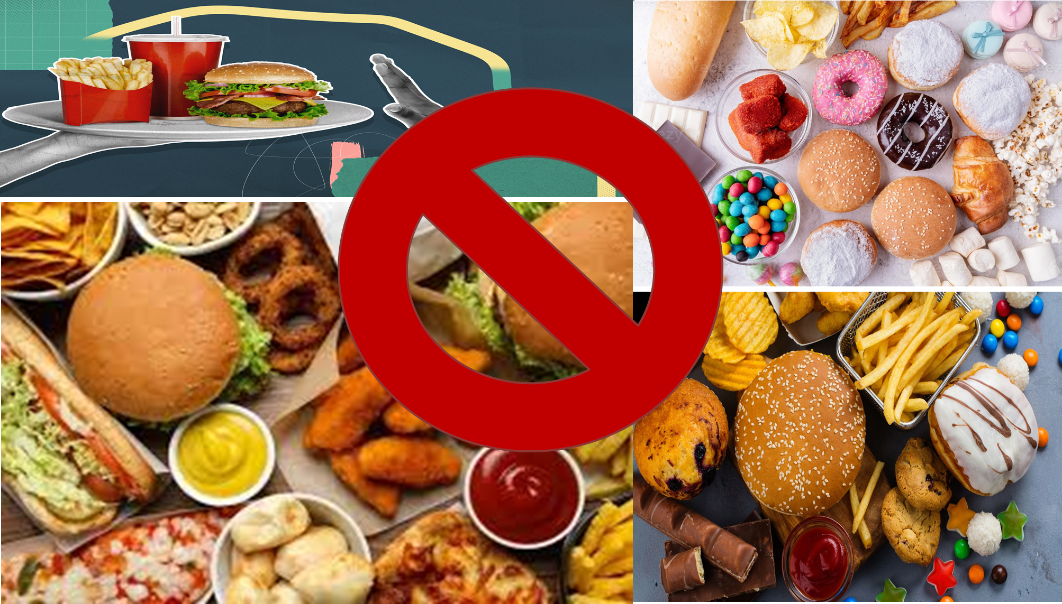

Slide 2
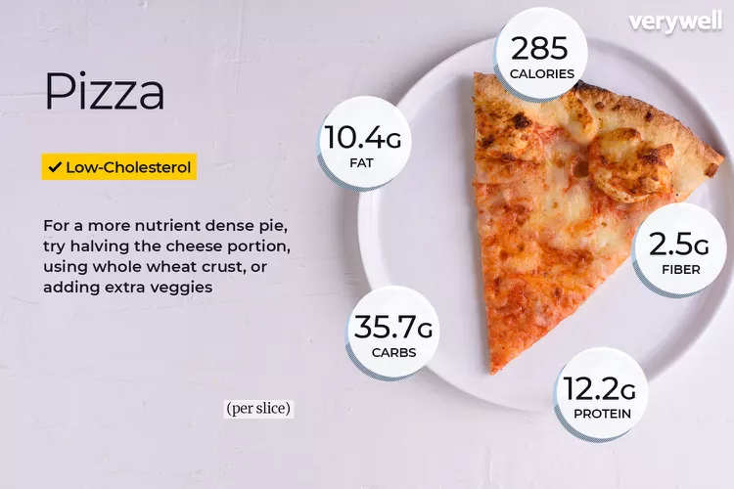

Slide 3

JUNK FOOD EATERS, BE READY!!

Slide 4
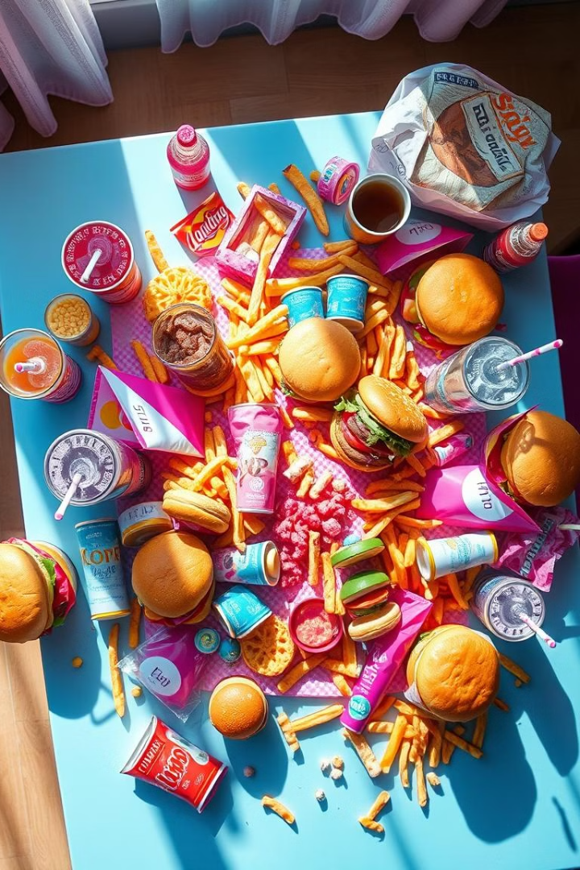
The Hidden Dangers: Fast Food and Physical inactivity
This PPT explores the serious health consequences of consuming junk food. We will address issues like physical inactivity and unhealthy eating habits. Learn how junk food impacts your Body and Mental health.

Slide 5
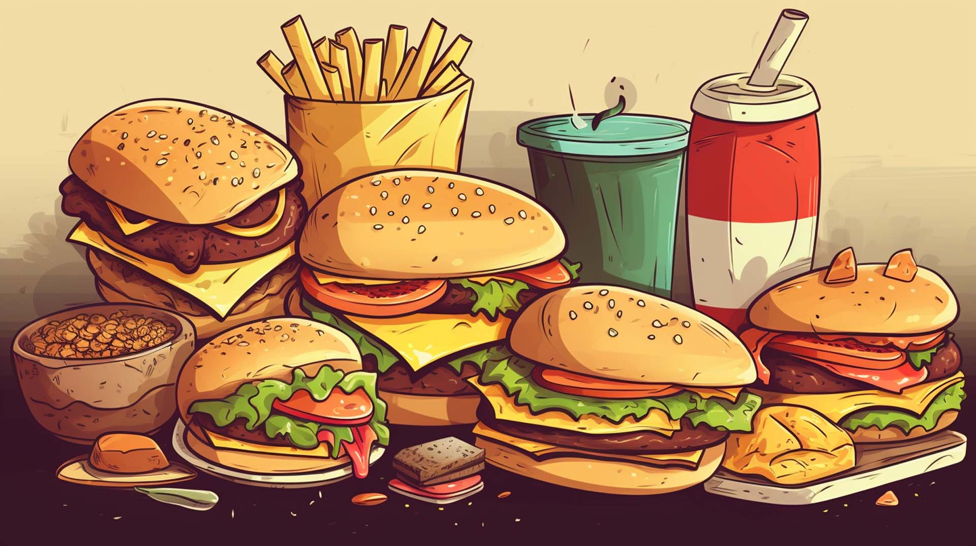
Defining Junk Food & Its Appeal
What is Junk Food?
The Crave Factor
Junk food is designed to be hyper-palatable. This means that it stimulates reward centers in our brains. This leads to cravings and overconsumption.
Junk food is typically high in calories. It's also high in unhealthy fats, sugars, and sodium. These foods often lack essential nutrients.
Junk means old or discarded things that are considered useless or of little value.

Slide 6





The Gut Connection: Junk Food & Your Digestion
Unhealthy Bacteria
Inflammation
Weakened Immunity
Junk food promotes the growth of unhealthy gut bacteria and also influences brain function .
An imbalanced gut microbiome triggers inflammation. This is linked to many health and mental concerns.
A compromised gut affects the immune system.

Slide 7
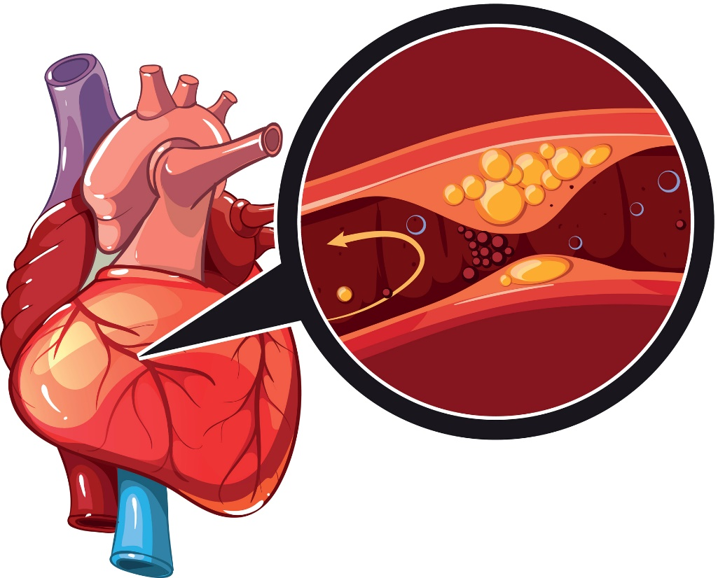
Cardiovascular Problems: A Ticking Time Bomb
Junk food consumption leads to heart issues. Saturated and trans fats increase bad cholesterol. This causes plaque buildup in arteries.
1
Increased Cholesterol
Bad cholesterol builds up in the arteries.
2
High Blood Pressure
Sodium leads to hypertension. This is high blood pressure.
3
Silent Heart Attack
It is one of the most threatening consequence, and as it’s name suggest it occurs with a mild pain and can lead to Death.

Slide 8
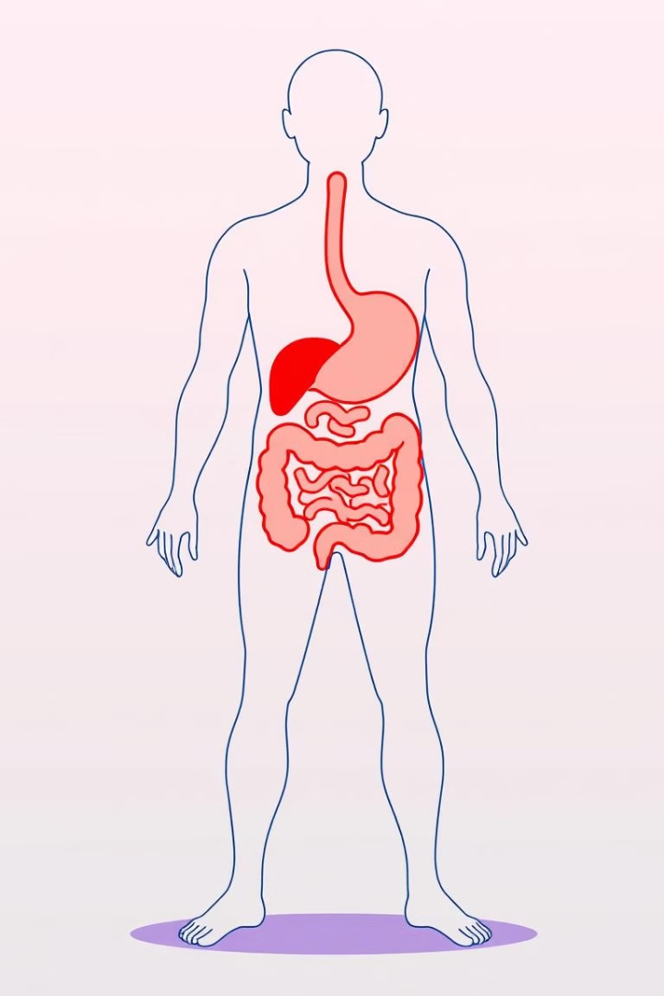



Long-Term Consequences: Obesity, Diabetes, & Heart Disease
Obesity
Diabetes
Heart Disease
Excess calories from junk food lead to weight gain and obesity. This is a major risk factor for many diseases.
High sugar intake increases insulin resistance. This can lead to type 2 diabetes.
Unhealthy fats raise cholesterol levels. This increases the risk of heart disease and stroke.

Slide 9
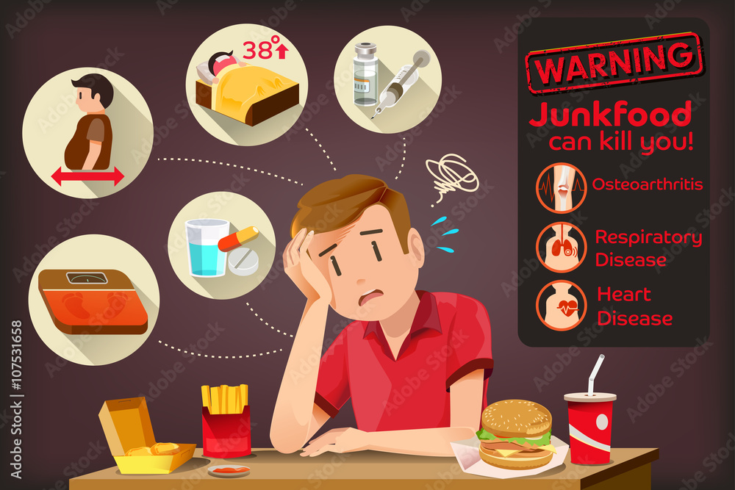

Mental Health Risks of Junk Food
1
Cognitive Decline:- Junk food consumption harms cognitive abilities and brain function.
Increased Risk of Dementia:- Processed food-rich diets may raise dementia risk later, said by researchers
2
Mood Disorders:- Junk food may raise depression and anxiety risks by affecting brain chemistry and inflammation.
3
Putting Junk Food into your body is like dumping garbage into a temple

Slide 10
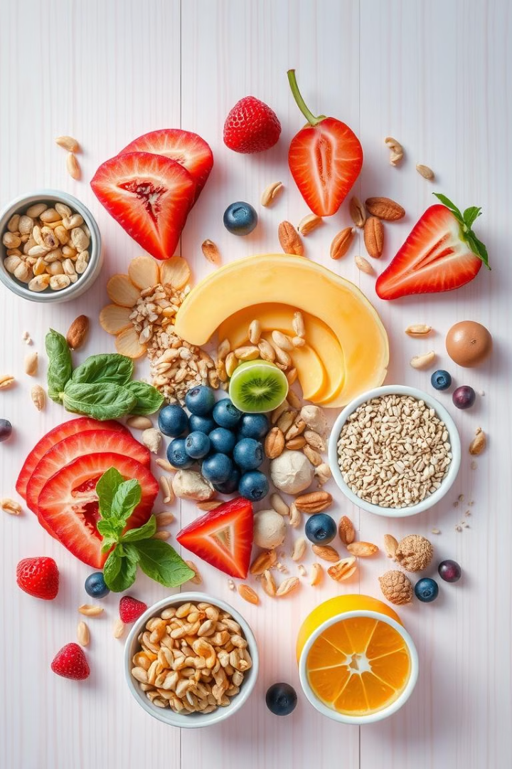
Simple Swaps: Healthy Alternatives & Mindful Eating
1
Choose Whole Foods
Opt for fruits, vegetables, and whole grains.
2
Read Labels
Check sugar, fat, and sodium content before buying.
3
Practice Mindful Eating
Pay attention to hunger cues.

Slide 11
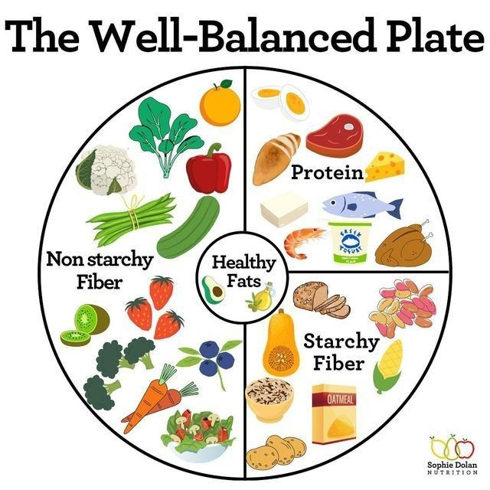
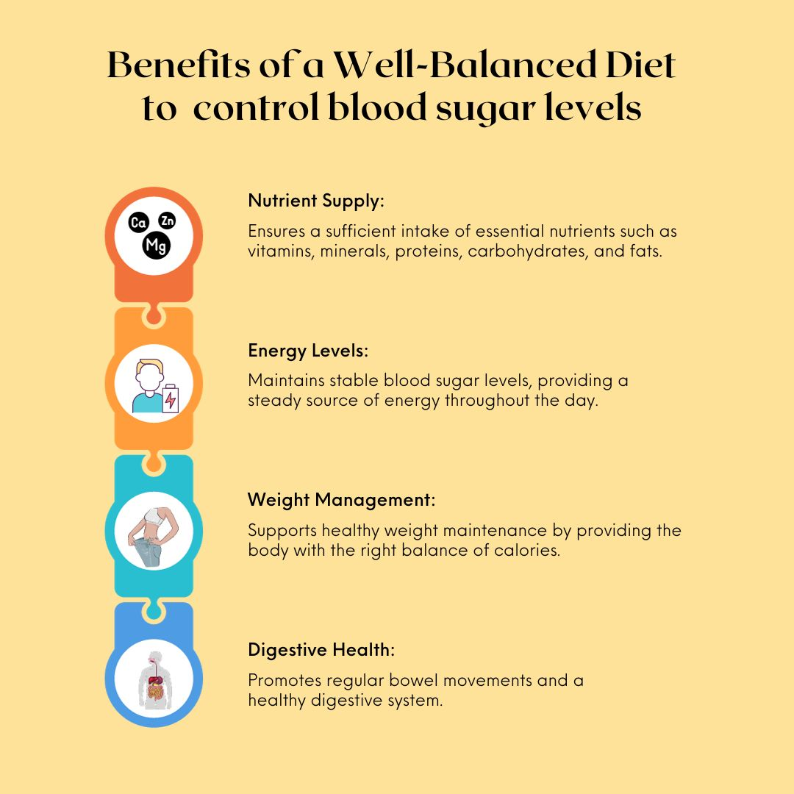
BALANCED DIET

Slide 12
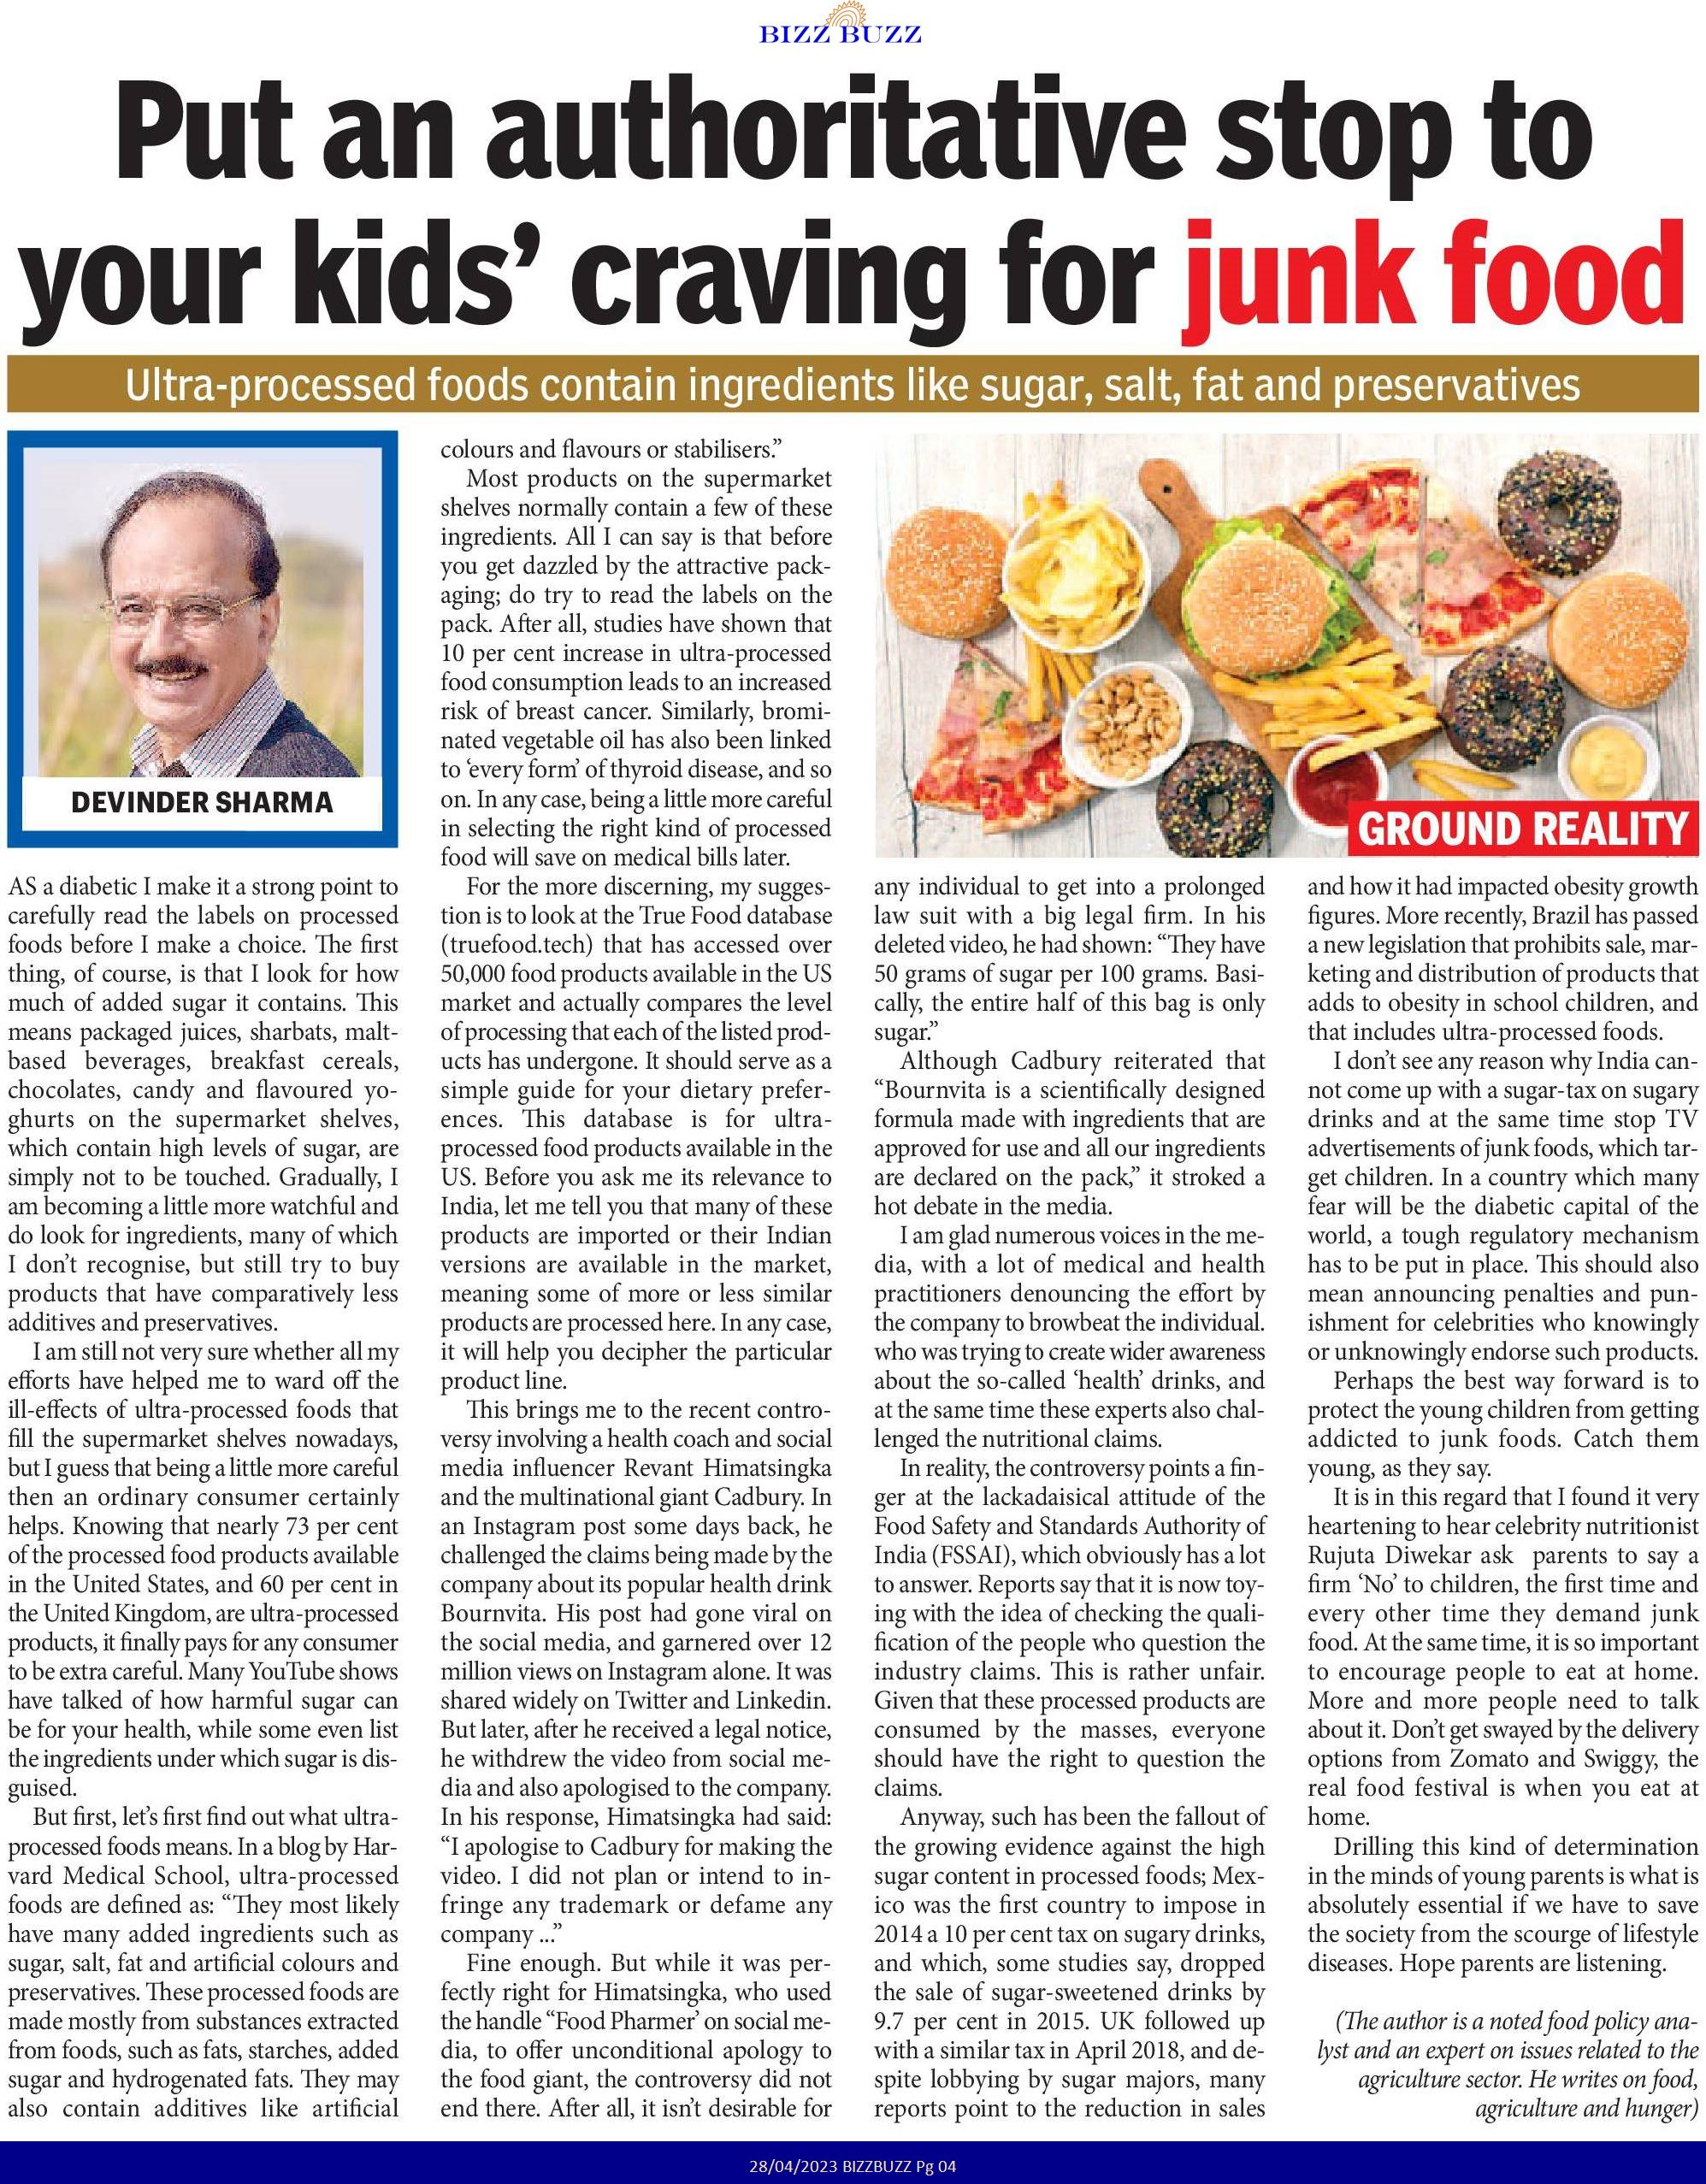
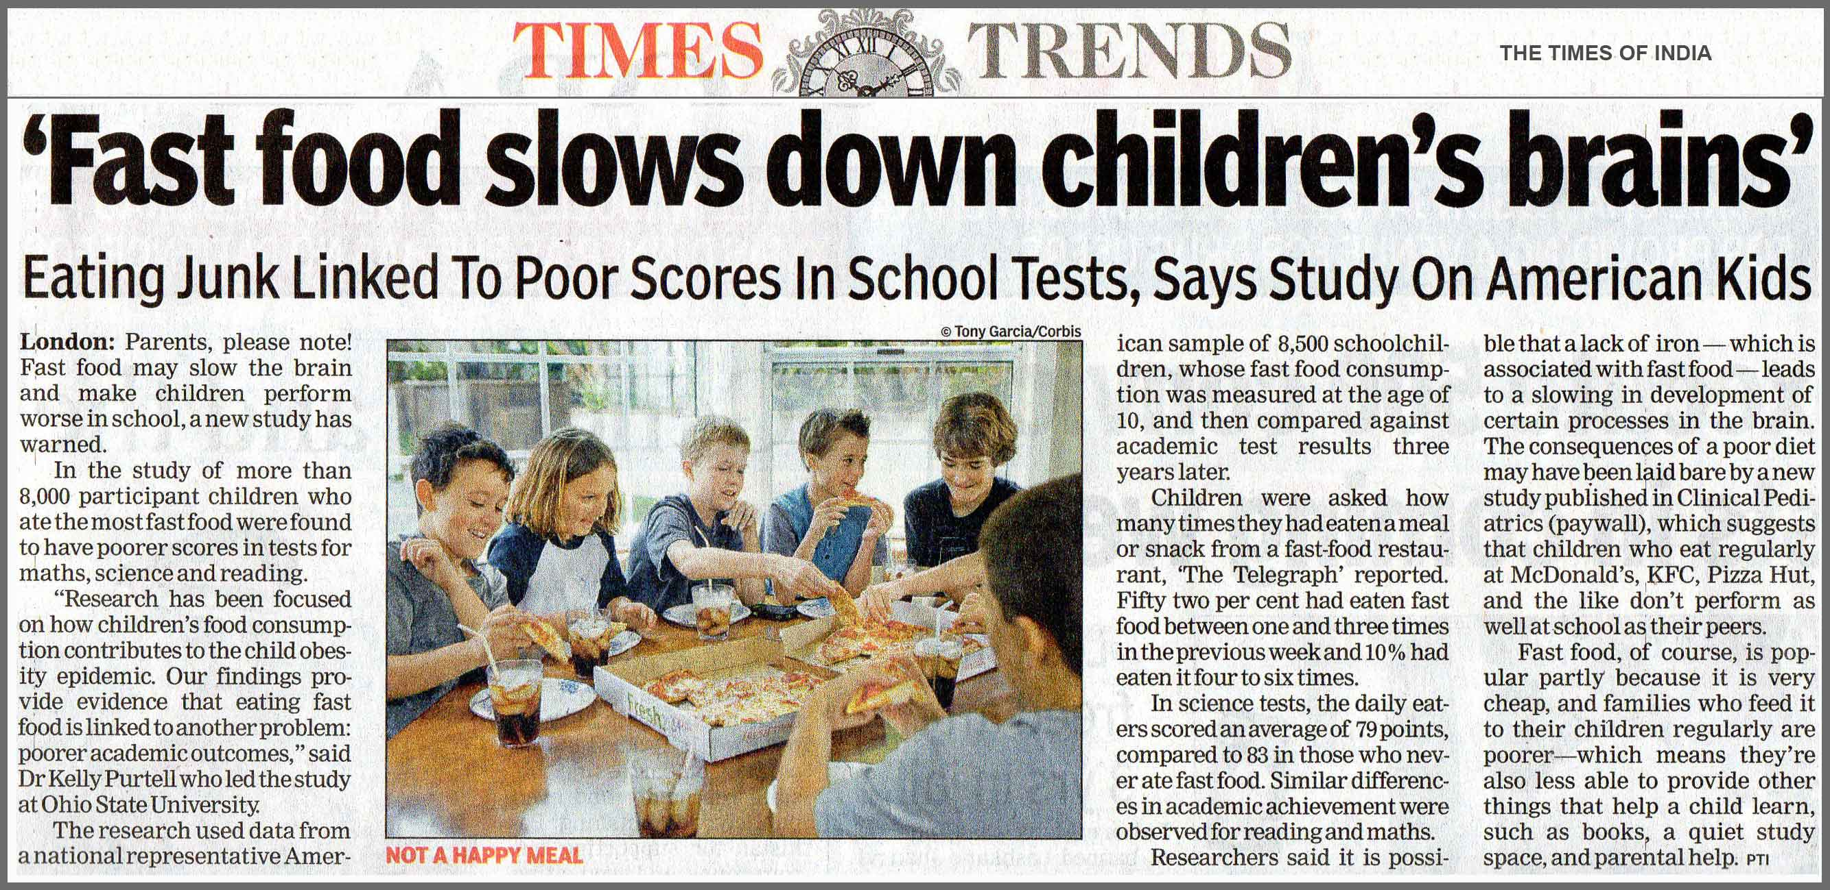
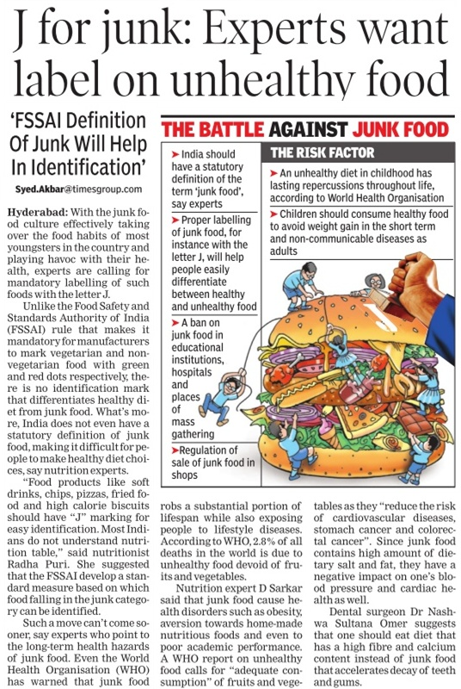
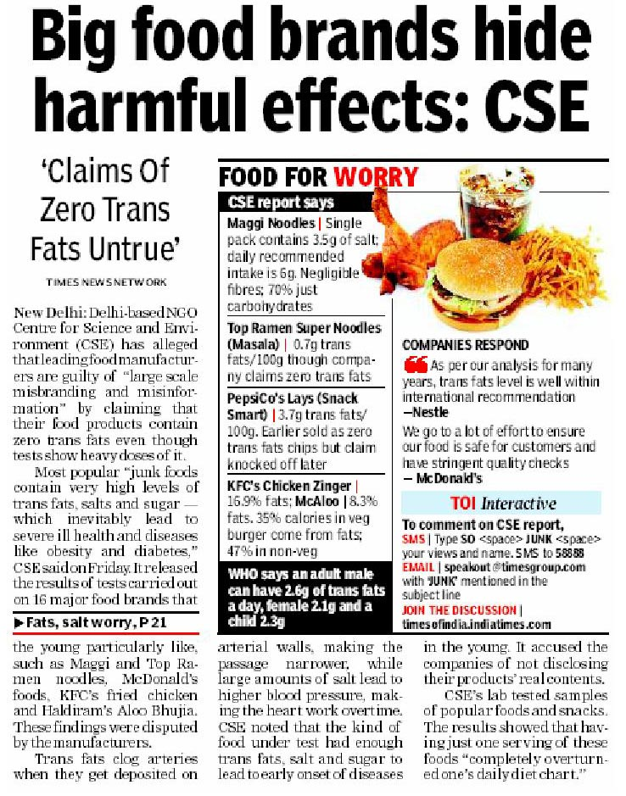
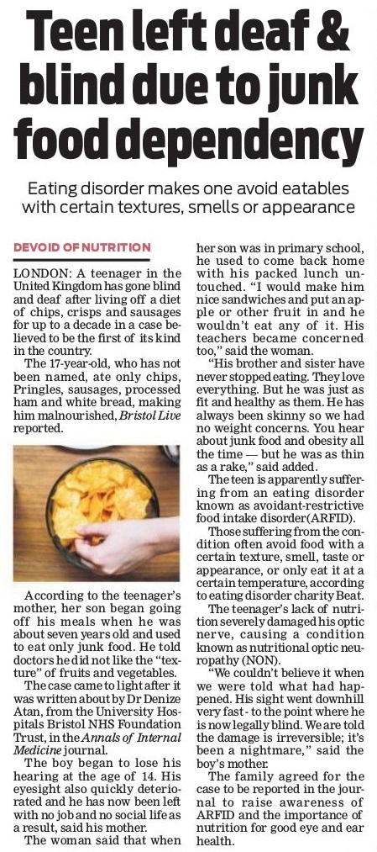
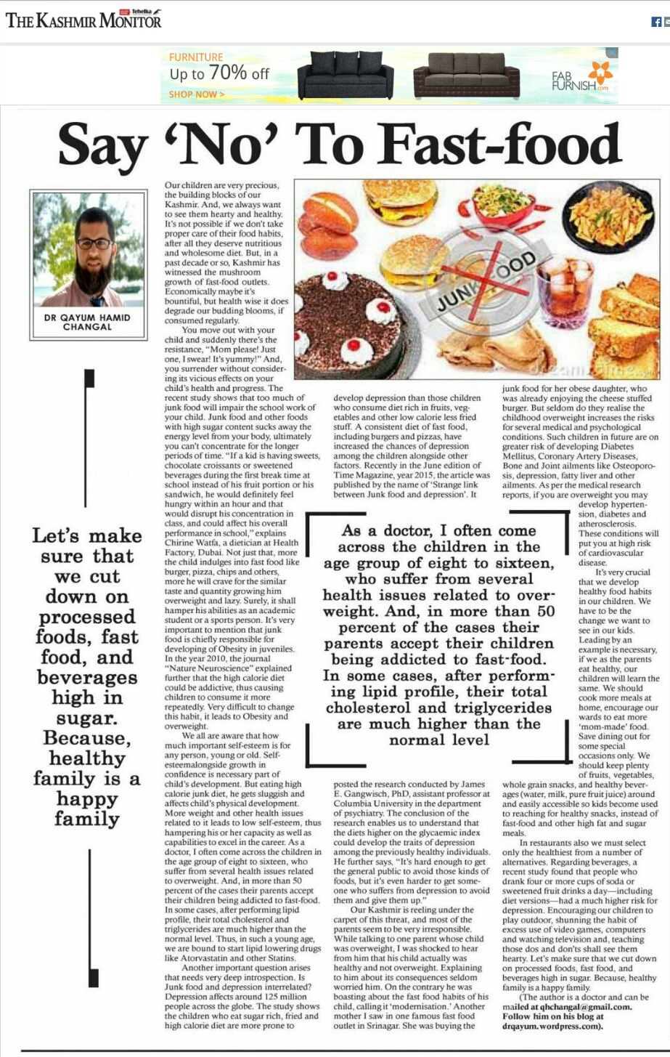
Supporting Evidence

Slide 13
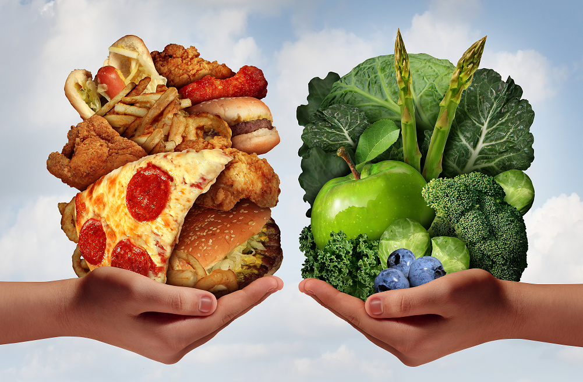
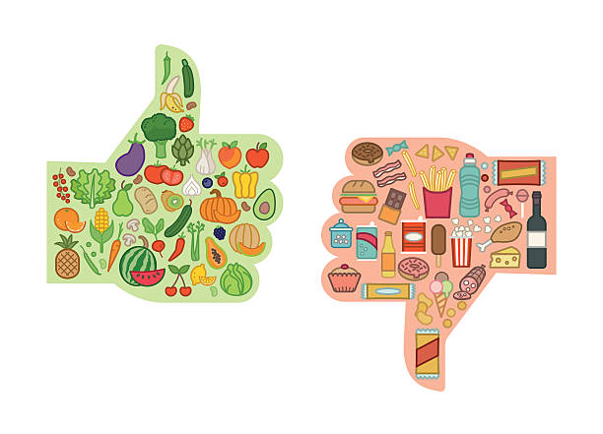
CHOOSE WISELY!!

Slide 14
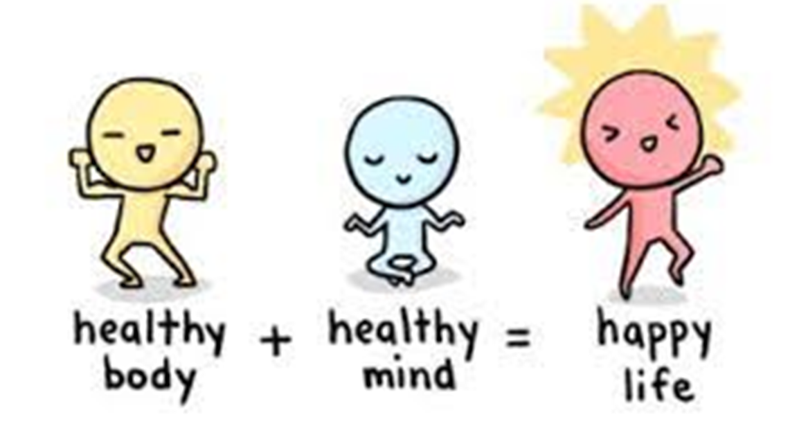
Think before you bite—junk food today, health problems tomorrow!

Slide 15
For more information visit our website
https://docs.google.com/forms/d/e/1FAIpQLScqliaN8wmzsqkCvSeLlyrWL0n4GIFyvLLxrr3Z0XeHQG9TMg/viewform?usp=dialog

